Slide 1



Group Report on Koan 6
2018302461 王云泽
2018380115 Wong mann theng
2018302462 沈昊天

Slide 2

Index
NN analysis
Realization
Extrapolation
Ideas

Slide 3
Neural network analysis
The Braitenberg Vehicles are based on neural network design. In this project the goal is to “Develop a layered controller architecture. One layer for simple obstacle avoidance behavior. Another layer for attraction/repulsion behavior towards/from other pioneer robots in the environment.”
So how do we achieve this?

Slide 4
Neural network analysis
To detect the obstacles and other Braitenberg Vehicles, there has to be sensors on board.
Ultrasound sensor for distance.
Light sensor for interactions.

Slide 5
Neural network analysis
L
R
L
R
L
R
OL
OR

Slide 6
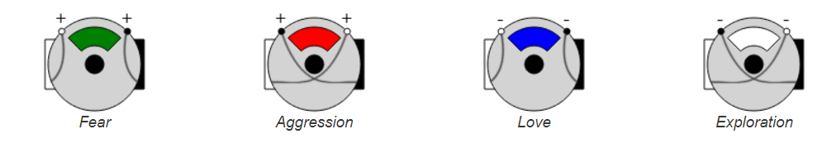
Neural network analysis

Slide 7
Realization
Two-wheel robot platform
With a third omni-directional wheel
STM32 controlled with sensors

Slide 8
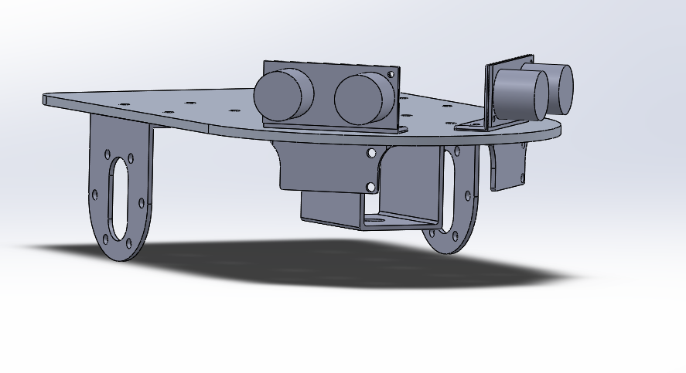
Mechanical design

Slide 9
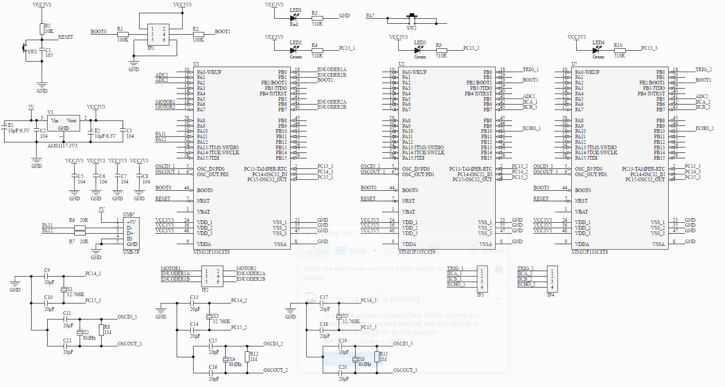
Core system schematics

Slide 10
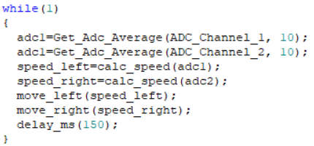
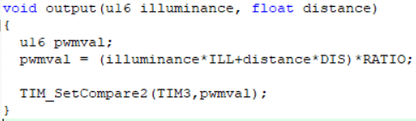
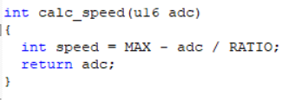
Stm32 program

Slide 11
Extrapolation: love and explore
Love bot and explore bot are quite the opposite.
What happens when they contradicts each other?

Slide 12
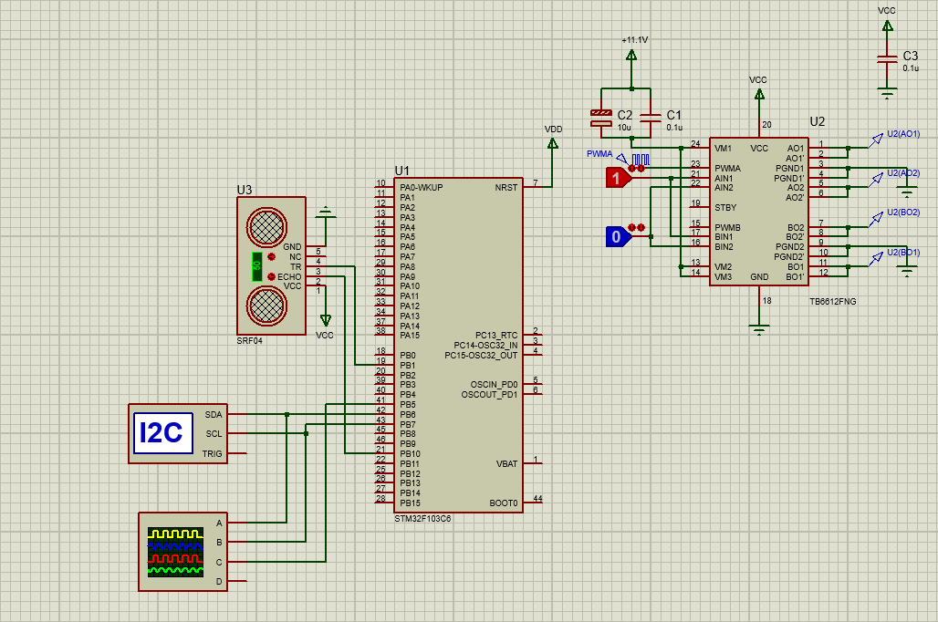
Hardware simulation

Slide 13
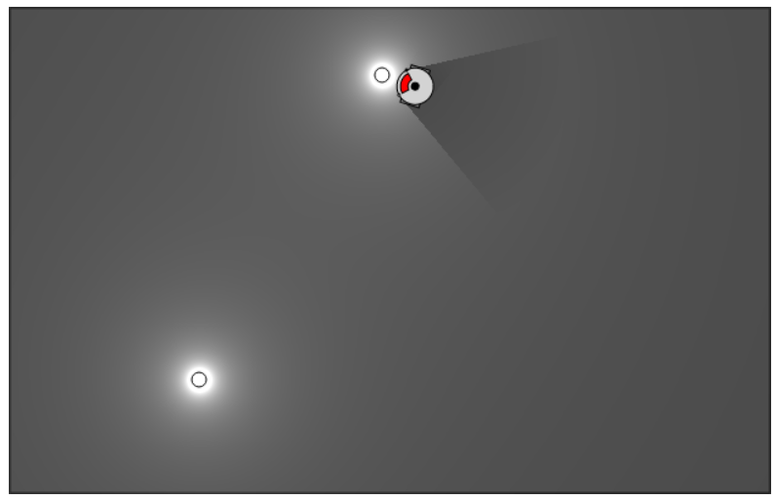
Behavioral simulation
Copyright 2016 Harmen de Weerd

Slide 14
ideas
Braitenberg Vehicles are good examples for study, so are they useful in reality?
Multiple sensors?
Other platforms that does not use wheels?

Slide 15
Tools, components and copyrights
Software used:
Altium Designer 20.0.1
Proteus 8 Professional
SolidWorks Premium 2019 SP4
Keil μV5.16.0

Slide 16
Tools, components and copyrights
Hardware components used (major modules):
STM32F103C8T6
GY-302 (BH1750FIV)
HY-SRF05
TB6612FNG
MG530P60_12V

Slide 17
Tools, components and copyrights
Copyright tools, data references and materials:
STM32 library from OpenEdv (http://www.openedv.com)
Braitenberg Vehicle simulator by Harmen (http://www.harmendeweerd.nl/braitenberg-vehicles)
Research reference on “A model and formal analysis of Braitenberg vehicles 2 and 3” (DOI: 10.1109/ICRA.2012.6224583)

Slide 18

Project repository
THANK YOU!
https://github.com/Firefox2100/Braitenberg_Vehicle_AI_Project

